Slide 1

First Steps with R in Life Sciences: Introduction
With slides from: Diana Marek, Geoffrey Fucile, Alex Smith, Linda Dib, Leonore Wigger, Wandrille Duchemin

Slide 2

General Information
Course page: https://github.com/sib-swiss/first-steps-with-R-training
Slides
Data sets
Exercises
Solutions
Optional exam, 0.5 ECTS value

Slide 3



Asking questions - Communication
Raise your hand anytime
Done with an exercise?

Slide 4
Introducing Ourselves

Slide 5
What type of computer OS are you using? - Windows - MacOS - Unix/Linux (Ubuntu, CentOS,...)

Slide 6
Do you know other programming languages? - None - Yes, but only notions - Yes, and I am proficient

Slide 7
What is your experience with R? - I have never tried to use R - I have run a few commands or done a few exercises - I have use R a little for work or personal project - I have used R extensively (wait, why am I even here?)

Slide 8

Course Content: R is vast, it can't be learned overnight. This course will give a basic understanding and concepts of R. This course is the first step in your journey

Slide 9
Course Outline
Day 1
Getting Familiar with R and Rstudio
Getting started with the R syntax and Objects
Formatting your data
Importing/exporting data with R (working with files)
Day 2
Building Graphics in R (basic plotting)
Doing statistics in R

Slide 10
Getting Familiar with R and Rstudio

Slide 11

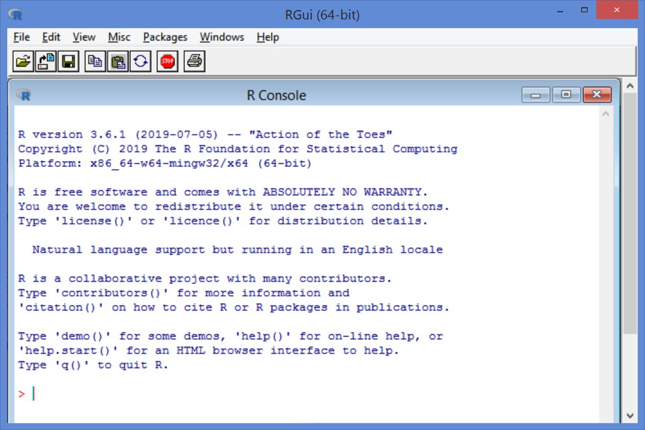
RGui (R Graphical user interface)
Installed at the same time as the programming language

Slide 12
R combined with Rstudio
www.rstudio.com
Integrated Development Enviroment (IDE) designed to help with R
It includes:
A console
A syntax highlighting editor
Tools for viewing the workspace and history
A file explorer, package explorer, plot and help display areas
We suggest Rstudio as the preferred option when working with R

Slide 13
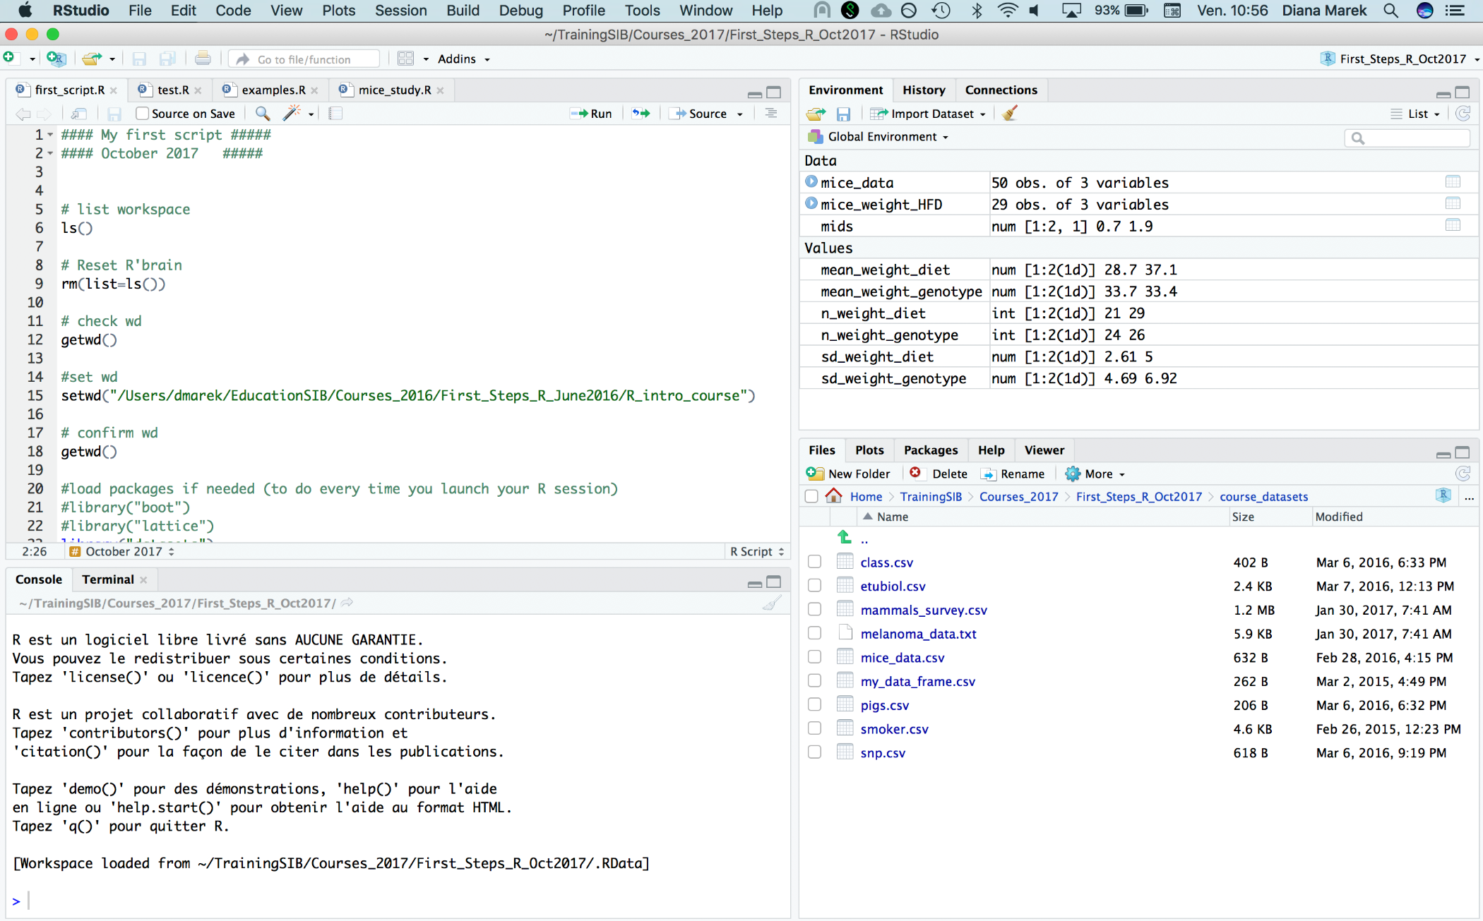
Rstudio Interface
Workspace, history
Editor
Console, terminal
File explorer, plots, packages, help

Slide 14
Creating an R project
Rstudio allows the organization of your work in projects
File > New Project or click on "Project" in the upper-right corner
Choose New directory, then New Project, give an appropriate name and location
OR choose Existing Directory
This creates an .Rproj file in the directory
The project directory automatically becomes the "working directory"

Slide 15
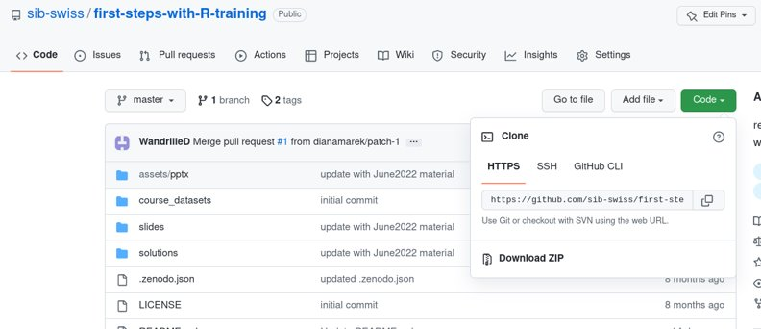

Let's practice - 1
Outside Rstudio : prepare the course data for the exercises
Download the course material from :
https://github.com/sib-swiss/first-steps-with-R-training
Either use git clone OR click Download ZIP
and UNZIP and then move the folder where you want it
Inside Rstudio: project setup
In Rstudio, create a new project set in the folder of the course material you just recovered.

Slide 16
Console: the command line
The ">" indicates R is ready for a new command

Slide 17
Try it out:
Type the following at the command prompt:
Simple calculation:
1+1
Pre-defined function:
abs(-11)
Assigning a value to a variable
x <- 128.5
Displaying a variable's content
x
After each command,
Hit the return key to execute it

Slide 18
R key concepts
Variable: a storage space in memory with a name
temp <- -5.5 #creates a variable named temp, holding value –5.5
Type:
Numeric: any number. Such as 128.5, 13, or –5.5
Character: text, such as "Hello", 'test', or "-13" (notice the quotes)
Function: pre-written code to perform a specific task
Can be executed by "calling" the function:
function name followed by parentheses, with eventual arguments between the parentheses
abs(temp) # absolute value of variable temp
log2(16) # base-2 logarithm of 16
q() # quit R
Operator: used for arithmetic, logical or other operations: +,-,*,/,^,…
Comment: everything after a # character is not interpreted as code

Slide 19
R key concepts
Working directory: where the R session is currently executing
By default, this is where R looks to files to write/read
See the current working directory:
getwd()
[1] "C:/Users/....../Rcourse"
Change the working directory:
setwd("D:/cool_R_project/")
In a Rstudio project, we usually do not need to the change the working directory

Slide 20
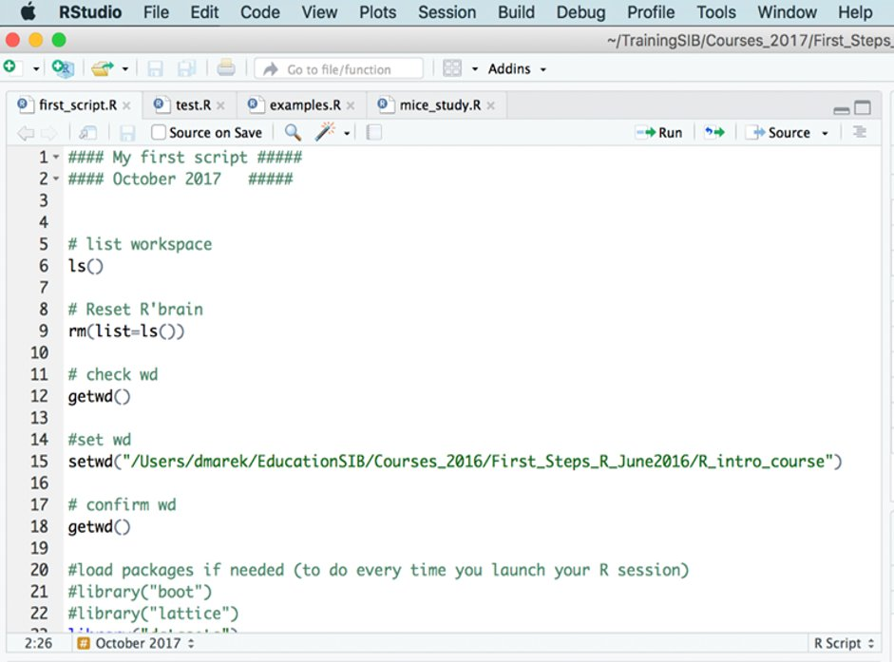
Editor: writing code in a file

Slide 21
R scripts
A script is a normal text file which contains commands meant to be executed one after the other.
Write your code into a script and save it
to document your analysis as you do it
to be able to re-use that code later and create variations
for easy execution
In Rstudio : File > New File > Rscript or Ctrl+Shift+N
Save often! (File > Save or Ctrl+S)

Slide 22
Most of your code should be in scripts Code in scripts is "just text", it gets executed when you send it to the console It is possible to run an individual code line, a block of code or an entire script at once

Slide 23
Sending code from the editor to the console
Ctrl+Enter (Windows and Linux)
Cmd+return (Mac)
click the "Run" button
By default, the current line is executed,
if something is selected, then this is executed (e.g., part of a line, or multiple lines)

Slide 24
Workspace
The workspace is the internal memory storing the R object creating during this session
List the workspace elements:
ls()
Removing an object from the workspace:
rm(x)
Recipe to remove everything:
rm(list=ls())

Slide 25
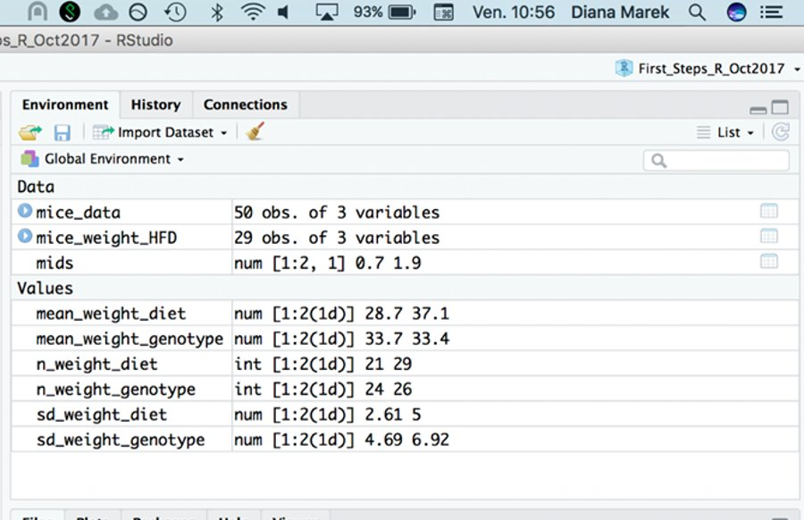
Workspace in Rstudio

Slide 26
Let's practice - 2
Prepare your first script
Open a script file and save it.
Type or paste the following code
# First steps with R, ex1
w <- 3
h<- 0.5
area <- w*h
area
Look at the script (before running it) can you understand each line? What do you expect it to print to the console?
Run the script and explore Rstudio's feature:
Run the script line-by-line or Run all lines at once by selecting them

Slide 27
Closing or Switching Projects
Closing a project: File > Close
Switch to another project: File > Open Projects...
Open another project but leave the current one open: File > Open Project in New Session
In your computer's file explorer, double-clicking a .Rproj file with open a project
When closing or switching project, the workspace and history are cleared
(Tools > Global Options > General to change this behavior)

Slide 28
Closing or Switching Projects
Closing a project: File > Close
Switch to another project: File > Open Projects...
Open another project but leave the current one open: File > Open Project in New Session
In your computer's file explorer, double-clicking a .Rproj file with open a project
When closing or switching project, the workspace and history are cleared
(Tools > Global Options > General to change this behavior)
history and workspace can be saved in an .Rhistory and .Rdata file

Slide 29
Let's practice - 2bis
Look at your project option (Tools > Project Options). If needed, modify them to save your workspace and history and to restore them at startup.
Check that it works:
Close Rstudio
Double-click the .Rproj file
Does the project open? Is your workspace empty?
Check other behaviours:
Close your project
Open your project again from Rstudio

Slide 30
Saving the Workspace (.Rdata file)
You have the option of saving one or several variable to a file for later use
save.image("my_workspace.RData") # saves the entire workspace
save(x,y,file="precious_objects.RData") # saves specific objects
You can use load() to read the objects in any R session:
load("precious_objects.RData")
This is useful to save intermediate results files
Or to pass a bunch of R objects to someone else

Slide 31
Packages
Libraries of related functions (and sometimes datasets)
Basic R only has a small number of packages
Many, many packages are developed by the community and can be installed as needed
Two main repositories for life science
CRAN (cran.r-project.org): main R repository
Bioconductor (bioconductor.org): specialized in bioinformatics / -omics data analysis

Slide 32
Installing / loading packages
install.packages("stringi") # looks for and installs the package named stringi
Installation is done only once per computer (or if you reinstall/upgrade R version)
Library(stringi) # loads library stringi
# -> makes its content available in the R session
Loading is done at each session, usually at the beginning of a script

Slide 33
Session information
Getting precise information about your session can be useful for debugging
This information is usually required to get help online
R.version.string : prints the curretnly used R version
sessionInfo() : prints version information about R and loaded libraries

Slide 34
Getting started with the R syntax and Objects

Slide 35
Basic data types
Numeric:
Number, stored with decimal point
Examples: 0, 1, 55.2, -11.1111
In some context, this type is labelled "double"
Integers, stored without the decimal points, exist but are rarely used
Character:
Text sequence. Must be enclosed in quotes : " " or ' ' (either work)
Examples: "1a++", 'Hello World, "s" , "99"
Logical:
TRUE or FALSE (all upper case)

Slide 36
R syntax
Case sensitive: R differentiate lower and upper case letters
Commands can be separated by a newline or a semicolon ; (but newline are preferred for readability)
Long statements can be written on several lines
R has no strict rules about the number of spaces around elements. Use your best judgment and be consistent.
The # character stands for comments

Slide 37
R objects
An object is a storage space that contains a value, a data structure, or some code.
Almost everything in R is an object!
Variables are object containing data
Functions are object containing code

Slide 38
Object name rules
Letters, numbers, dots . , and underscores _
Cannot start with a number
Cannot contain operators
Best to start with a letter
Examples:
X
mydata1
mydata.normalized
N_times

Slide 39
The assignment operator
We can use either <- or = to assign values to object.
Stick to one for consistency.
x <- 10 # Create object x, assign value 10 to it
x <- 25 # change the value of x to 25
myNumber <- 15
x <- myNumber # both x and myNumber now contain 15
x <- x + sqrt(16) # add the square root of 16 to x

Slide 40
Using functions (I)
Functions are called with parentheses () after the number name
Arguments are the input ti functions, passed inside the ()
ls() # no arguments
sqrt(81) # one argument
rep(1, 2) # two arguments, separated by a comma ,
Arguments have names which can be used when calling a function
rep(x=1, times=5) # named args. Equivalent to rep(1,5)
rep(1, times=5) # mixed unnamed/named
Use ?function_name to check R's help and see which arguments
a function expects

Slide 41
Using functions (II)
Many functions take more than one argument
If unnamed, arguments must be listed in the correct order (association by position)
If named, arguments can be passed in arbitrary order (association by name)
write.table(object, "outfile.txt" , TRUE)
write.table(object, append=TRUE, file="outfile.txt")

Slide 42
Using functions (III)
Some functions have arguments with default values
Example: round()
Usage (from R help): round(x, digits = 0)
Arguments with default values can be omitted in the function call.
Arguments without default values cannot be omitted.
round(2.011) # rounding to 0 digits, the default
[1] 2
round(2.011, 2) # rounding to 2 digits after the decimal point
[1] 2.01

Slide 43
Using functions (IV)
Using and understand the help/documentation is 50% of what makes a programmer
?paste
?round
?sqrt
Also, internet is your friend:
Google "R how to compute square root"
https://stackoverflow.com/questions/tagged/r

Slide 44
Let's practice - 3
Open a new script and save it
Assign the values 6.7 and 56.3 to variable a and b, respectively
Calculate (2*a)/b+(a*b) and assign the result to variable x. Display the content of
Find out how to compute the square root of variables. Compute the square root of a, of b, and of a/b
Calculate:
the logarithm of x
the logarithm in base 2 of x

Slide 45
Common Object Classes
vector: a series of data, all of the same type
matrix: multiple columns of the same length and data type
data frame: multiple columns of the same length, but each with their data type
list: collection of objects; can be of different classes and sizes
function: a command to perform a specific task

Slide 46
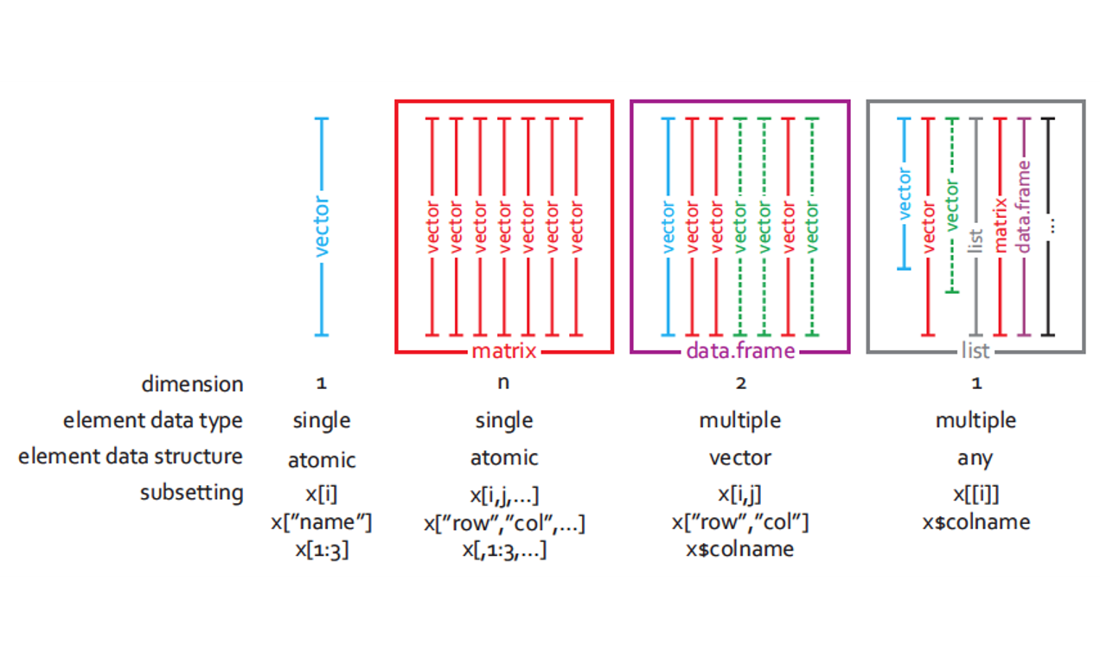
Common Object Classes

Slide 47
Vectors: simple usage
Create a vector using c() :
height <- c(180, 167, 199) # c() is for concatenate
Create a named vector:
height <- c(Mia=180, Paul=167, Ed=199)
Access elements with []:
height[1] # get the first element
height["Paul"] # get the element named Paul
height[ c(1,3) ] # get the 1st and 3rd element

Slide 48
Vectors: more creation recipes
a <- 1:10 # the : operator
1 2 3 4 5 6 7 8 9 10
s <- seq(0,2,0.5) # seq: from 0 to 2 by increment of 0.5
0.0 0.5 1.0 1.5 2.0
genotypes <- rep( c('WT','KO') , 3 ) # rep to repeat
"WT" "KO" "WT" "KO" "WT" "KO"
c(a,s) # c() can be used to concatenate 2 vectors
1.0 2.0 3.0 4.0 5.0 6.0 7.0 8.0 9.0 10.0 0.0 0.5 1.0 1.5 2.0

Slide 49
Vectors: manipulation (I)
a <- 1:4
a
[1] 1 2 3 4
a*2 # multiply each element of a by 2
[1] 2 4 6 8
a + c(12,10,12,10) # add the elements of 2 vectors
[1] 13 12 15 14

Slide 50
Vectors: manipulation (II)
Many functions take a vector as argument.
Some perform an element-wise operation. Example:
log2(a) # compute the logarithm in base 2 of each element
[1] 0.000000 1.000000 1.584963 2.000000
Some return a single value. Example:
mean(a) # compute the mean of the elements of a
[1] 2.5

Slide 51
Coercion (I)
All elements of a vector must be the same type
When combining different types, they are coerced to the most flexible type
Flexibility scale: logical < numeric < character
vec <- c(2,"twelve",TRUE) # combine 3 data type
vec # coerced to character
[1] "12" "twelve" "TRUE"
class(vec) # class() returns the type of a vector
[1] "character"

Slide 52
Coercion (II)
We can coerce a vector to any type with: as.logical() , as.numeric(), as.character()
Example: coerce a logical vector to numeric
FALSE becomes 0, TRUE becomes 1
mathematical functions automatically coerce to numeric
x <- c(FALSE,FALSE,TRUE)
as.numeric(x)[1] 0 0 1
sum(x) # number of TRUE
mean(x) # proportion of TRUE

Slide 53
Let's practice - 4
Create two vectors:
vector_a, containing the values from −5 to 5
vector_b, from 0 to 1 by increment of 0.1
Calculate the (element-wise) sum, difference and product between the elements of vector_a and vector_b. ​
Calculate the sum of elements in vector_a. ​
Calculate the overall sum of elements in both vector_a and vector_b.​
Identify the smallest and the largest value in vector_a​
Identify the smallest and the largest value among both vector_a and vector_b.​
Compute the overall mean of the values among both vector_a and vector_b.​
Hint: Each task in exercises 1-7 can be performed in a single statement per vector
(the minimum and maximum count as 2 separate tasks)​
EXTRA TASKS:
- use the seq() function to create a vector x containing 100 values equally spread between 0 and 5
- compute a vector y corresponding to the exponential of x
- compute and compare the means and standard deviations of x and y

Slide 54
Operators (most common ones)
Arithmetic: + , - , * , / , ^
Comparison: < , > , <= , >= , == (equal to),
!= (different from)
Logical: ! (negation), & (and), | (or)
Other: %in%
Comparison, logical operators, and %in% always return logical values (TRUE/FALSE)

Slide 55
Operators returning logical values
c(1,3,2) == 2
[1] FALSE FALSE TRUE
c(1,3,2) < 2
[1] TRUE FALSE FALSE
!(c(1,3,2) < 2) # ! Reverses TRUE and FALSE
[1] FALSE TRUE TRUE
c("Fred", "Marc", "Dan", "Ali") %in% c("Dan", "Geoff", "Ali")
[1] FALSE FALSE TRUE TRUE

Slide 56
Using logical vectors to subset
The [] operator can also accept a logical vector
a <- 1:4
a
[1] 1 2 3 4
a[ c(FALSE,FALSE,TRUE,TRUE) ] # select the elements where there is TRUE
[1] 3 4
a[ a>2 ] # the logical vector is provided by a logical expression
[1] 3 4
This sort of operation is extremely common
to subset some data

Slide 57
Missing values (I)
Missing values are usually represented by NA:
y <- c(1,2,3,4,5,NA,NA)
NA's interfer with many functions:
mean(y)
[1] NA
Arguments often exist to remove NA's before calculation
mean(y, na.rm=TRUE)
[1] 3
Alternatively, use na.omit() to remove NAs from the data
y_cleaned <- na.omit(y)
mean(y_cleaned)
[1] 3

Slide 58
Missing values (II)
x <- c(1, NA, 0/0) # 0/0 gives NaN = Not a Number
x
x [1] 1 NA NaN
is.na(x) #detects NAs and NaNs from x
[1] FALSE TRUE TRUE
is.nan(x) # detects only NaNs from x
[1] FALSE FALSE TRUE
x > 2 # what if we try to compare NA and NaN to a number?
[1] FALSE NA NA
x[!is.na(x)] # removes NAs and NaNs from x
[1] 1

Slide 59
Data frame: creation
We can create a dataframe from its individual column (each one is a vector)
name <- c("Joyce", "Chaucer", "Homer")
status <- c("dead", "deader", "deadest")
reader_rating <- c(55, 22, 100)
poets <- data.frame(name, status, reader_rating)
poets
name status reader_rating
1 Joyce dead 55
2 Chaucer deader 22 3 Homer deadest 100

Slide 60
Data frame: manipulation
poets[ 2 , 2 ] # gets the element on row 2 in column 2
poets[ , c(1,3) ] # gets columns 1 and 3
poets[ , c("name", "reader_rating") ] # gets columns "name" and
# "reader_rating"
poets$name # gets column "name"
rownames(poets) # gets the row names
colnames(poets) # gets the column names
rownames(poets) <- c("J", "C", "H") # overwrites row names

Slide 61
Let's practice - 5
Open a new script and save it as "Ex5.R".
In your script, write and execute the commands
library(MASS) # loads the library MASS
data(bacteria) # loads the bacteria data set (from MASS)
Check: You should have a variable named "bacteria" in your Environment.
What are the names of the columns of the bacteria data.frame ?
Use [] to select rows 100 to 119 of the column ap .
Use $ to get the column week and check how many 0 values it has.
EXTRA TASKS
using a comparison operator and [], select the rows which correspond to a “placebo” treatment (in the trt column).
Compute the fraction of "y" in columns y (hint: the function mean() can help).
Compute the same fraction but only among the rows corresponding to a "placebo" treatment. Same with a "drug" treatment, and with a "drug+" treatment.

Slide 62
Lists: creation
Lists are collections of object which may be of different classes and sizes
Create a few objects:
vec <- c(0.4, 0.9, 0.6)
mat <- cbind(c(1,1), c(2,1))
df <- data.frame(name=c("Ed", "Lisa"), age=c(61, 71))
Unnamed list - collect these objects in a list, using the function list():
l <- list(vec, mat, df)
Named list - collect these objects in a list with named elements:
l_with_names <- list(myvector=vec, mymatrix=mat, mydata=df)

Slide 63
Lists: manipulation
l[[1]] # gets the first object
l_with_names[["myvec"]] # gets the object named "myvec"
l_with_names$myvec # gets the object named "myvec"
names(l_with_names) # gets the list elements' names
names(l_with_names) <- c("A", "B", "C") # overwrites names
Lists can be used to collect a diverse sets of objects related to the same analysis

Slide 64
Everything in R is an object Using R is all about creating and manipulating data objects using functions Objects have a class (vector, data frame, list,…) Data in objects have a type (numeric, character, logical)

Slide 65
Formatting your Data

Slide 66
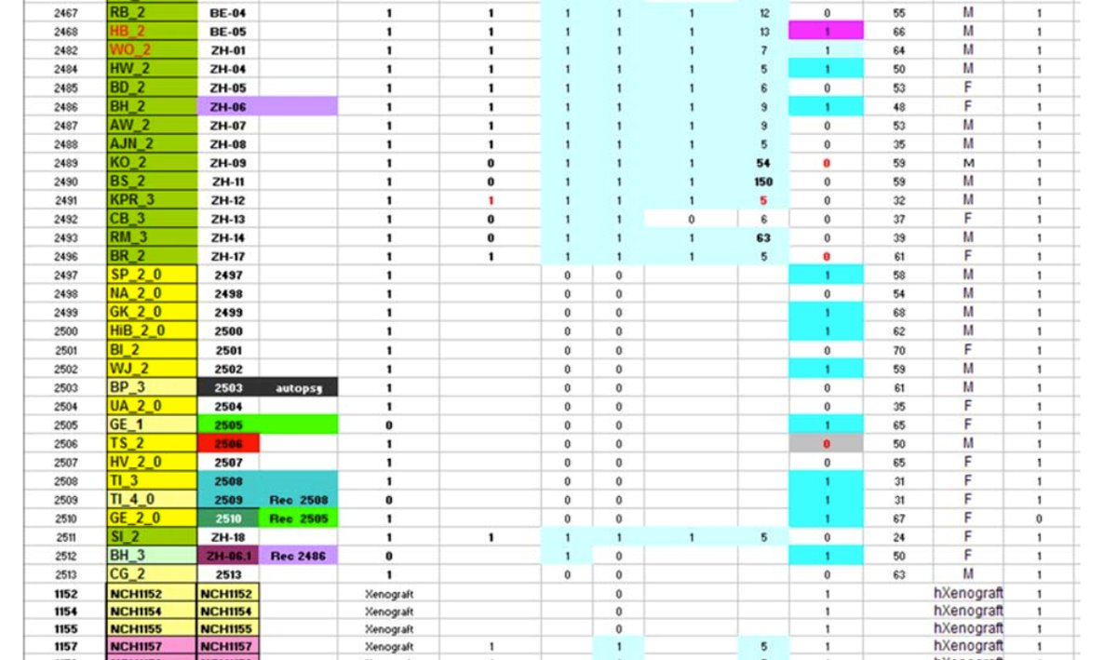
Example of a bad dataset
Difficult to use with any
Statistical program
Courtesy of Frederic Schuetz

Slide 67
Prepare your Data outside of R
To make importation of your data in R easy, you have to format it properly beforehand.
Excel or OpenOffice can be used for that task.
Three main precepts of tidy data:
Each variable forms a column
Each observation forms a row
Each type of observational unit forms a table
http://www.ucd.ie/ecomodel/pdf/TidyData.pdf

Slide 68
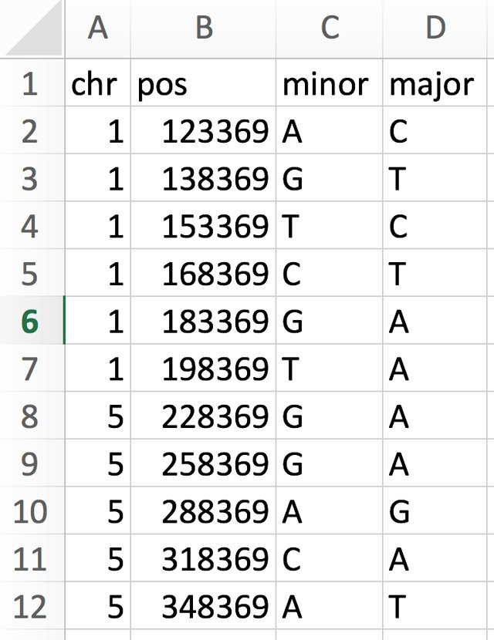
Example of a well-formatted dataset
A header line with variable names
4 variables, 1 in each column
One observation per row

Slide 69
Example of a well-formatted dataset - metadata
Glossary for the snp data
snp single nucleotide polymorphism
chr chromosome
pos position
minor minor allele (a minority of individuals
have this letter at this position)
major major allele ( a majority of individuals
have this letter at this position)
+ data source, date of collection,...
Data is often useless without the accompanying metadata

Slide 70
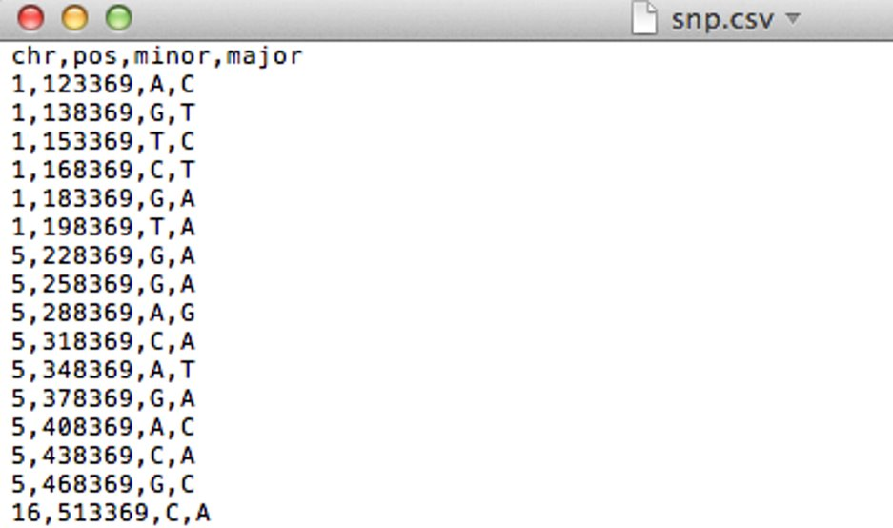
Saving your data
Export the spreadsheet to a text file format
csv (comma separated values), file extension .csv OR
tsv (tab separated values), file extension .txt or .tsv
Now you are ready to import this dataset in R

Slide 71
Formatting checklist/recommendations
First row is a header (column names)
First column contain row IDs
No blank spaces in column names (use _ instead)
Column names do not contain symbols other than _
Short column names are better
Remove all comments or other content around the data table
--> put them in a metadata file
Indicate missing values with NA (spelled exactly like that)
Have data backups!

Slide 72
Importing/exporting data into R

Slide 73
Importing data
Most flexible function to read tabular data: read.table()
Reads a formatted text file
Imports it as a data frame
Many options, to accommodate most text files
Two main elements to give to read.table():
What/where is the file to read
What are the formatting options

Slide 74
Specifying the file to read (I)
Where is the file I want to import?
Look for your file in the file system.
Note its path: the succession of folders to access it
File paths can be specified as a string with '/' as separator:
"C:/Users/Leo/courses/data/snp.csv"
Or with a little help from the function file.path():
file.path("C:","Users", "Leo", "courses", "data", "snp.csv")

Slide 75
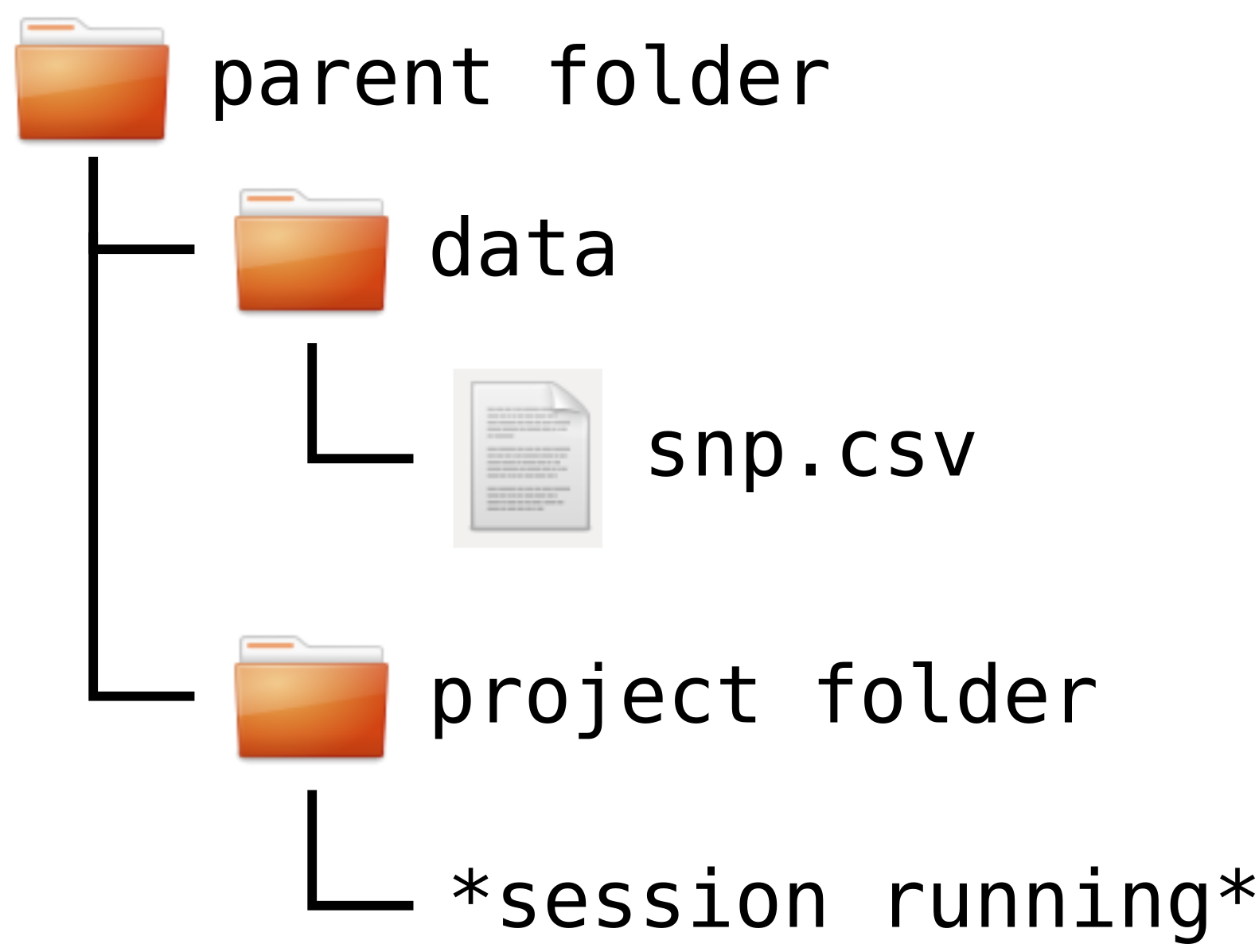
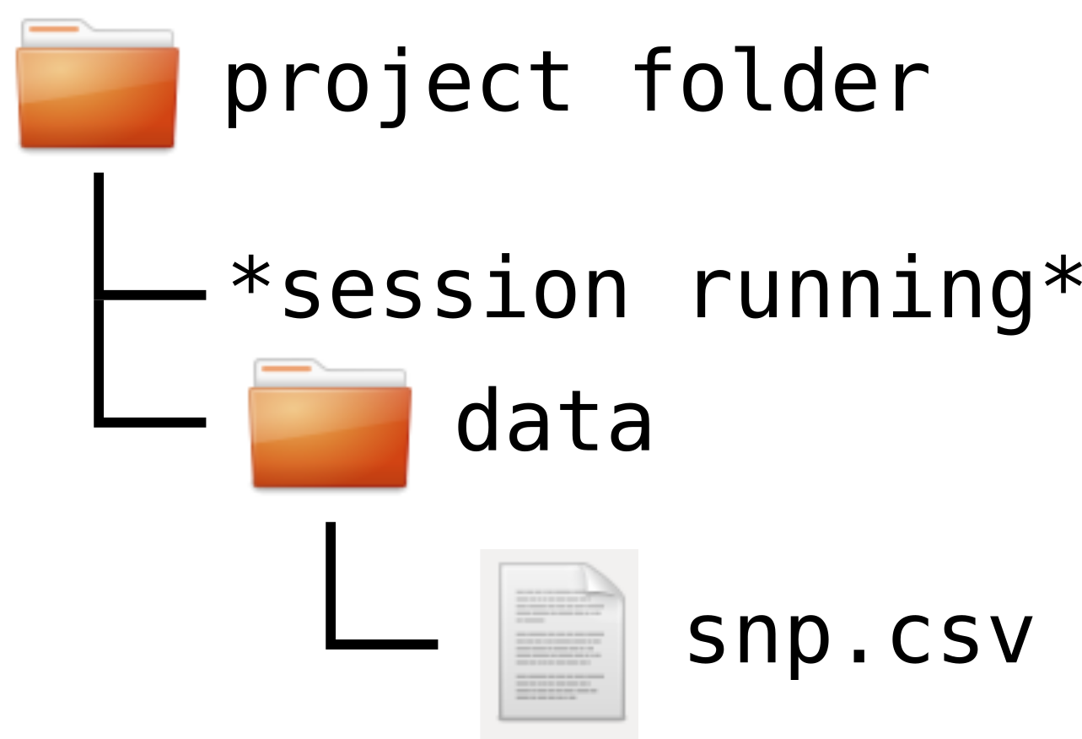
Specifying the file to read (II)
Files path can be absolute
"C:/Users/Leo/courses/data/snp.csv"
Or relative (to the working directory)
"data/snp.csv" "../data/snp.csv"

Slide 76
Format options
Most important optional arguments of read.table(), read.csv(), read.delim()
header (TRUE/FALSE): specifies whether the first line contains column names
Default in read.table() is FALSE.
Default in read.csv() and read.delim() is TRUE.
sep: specifies the field separator character (e.g. "," or tab "\t").
Default in read.table() is any white space characters (space, tab, newline and carriage return).
Default in read.csv() is comma.
Default in read.delim() is tab.
When in doubt, use help(read.table)

Slide 77
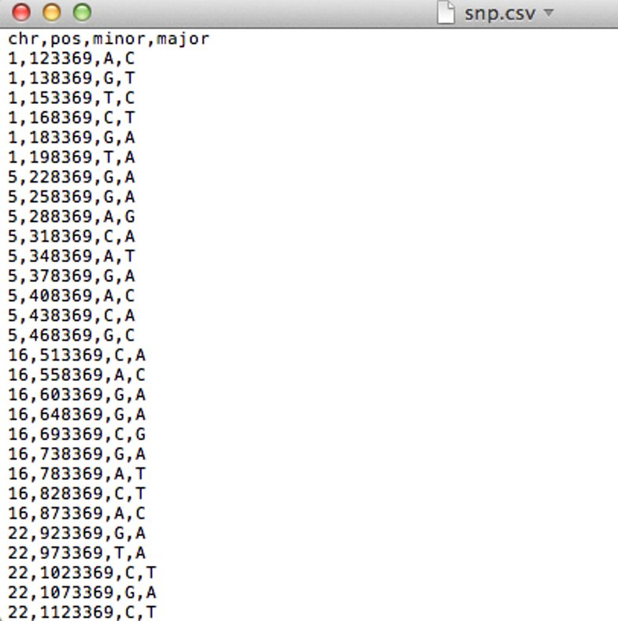
Importing snp.csv
Use read.table()
snps <- read.table("course_dataset/snp.csv",
header=TRUE, sep=",")
# we need to supply some arguments
Use read.csv()
snps <- read.csv("course_dataset/snp.csv")
# arguments can be omitted since defaults are adapted to .csv

Slide 78
Checking the imported data (I)
It is very important to check that the data was correctly imported.
head(snps) # shows first 6 rows (tail(snps) - shows last 6 rows)
chr pos minor major
1 1 123369 A C
2 1 138369 G T
3 1 153369 T C
4 1 168369 C T
5 1 183369 G A
6 1 198369 T A
dim(snps) # number of rows and columns
[1] 40 4
nrow(snps) # number of rows
[1] 40
ncol(snps) # number of columns
[1] 4

Slide 79
Checking the imported data (II)
colnames(snps) # column names
[1] "chr" "pos" "minor" "major"
str(snps) # structure of the data frame
'data.frame': 40 obs. of 4 variables:
$ chr : int 1 1 1 1 1 1 5 5 5 5 ...
$ pos : int 123369 138369 153369 168369 183369 198369 228369 258369 288369 318369 ...
$ minor: chr "A" "G" "T" "C" ...
$ major: chr "C" "T" "C" "T" …
R made its best guess for data types. Are they what we need?

Slide 80
Let's practice – 6a
A dataset from mouse experiments at 18 weeks is available in the file mice_data.csv in the course_datasets folder (courtesy of F. Schutz and F. Preitner). Let's explore the dataset to see what it contains.
Open a new script file in R studio, comment it and save it.
Have look at the csv file in R studio's file explorer. What do you need to check in order to be able to read in the file correctly?
Read the file into R, assign its content to object "mice_data". Examine the object.
How many observations and variables does the dataset have?
What is the structure of the dataset? What are the names and classes of the variables?

Slide 81
Digression: factors (I)
Factors is a datatype used to represent categorical data.
Some functions require factors (and not character) to work properly.
genotype <- factor(c("WT", "WT", "Mut2", "Mut1", "Mut2"))
[1] WT WT Mut2 Mut1 Mut2
Levels: Mut1 Mut2 WT
The available values in a factor are called levels.
levels(genotype)
[1] "Mut1" "Mut2" "WT"

Slide 82
Digression: factors (II)
By default factor levels are sorted alphabetically.
We can specify them manually (sometimes useful to set reference level in some stat applications)
genotype <- factor(c("WT", "WT", "Mut2", "Mut1", "Mut2"),
levels=c("WT","Mut1","Mut2"))
[1] WT WT Mut2 Mut1 Mut2
Levels: WT Mut1 Mut2

Slide 83
Setting factor variables
Convert categorical variables to factors as needed.
snps$chr <- factor(snps$chr, levels=c("1","5","16","22"))
snps$minor <- factor(snps$minor)
snps$major <- factor(snps$major)
str(snps) # structure of the data frame
'data.frame': 40 obs. of 4 variables:
$ chr : Factor w/ 4 levels "1","5","16","22": 1 1 1 ...
$ pos : int 123369 138369 153369 168369 183369 ...
$ minor: Factor w/ 4 levels "A","C","G","T": 1 3 4 2 3 ...
$ major: Factor w/ 4 levels "A","C","G","T": 2 4 2 4 1 ...

Slide 84
Getting a summary
summary(snps)
chr pos minor major
1 : 6 Min. : 123369 A: 9 A:17
5 : 9 1st Qu.: 340869 C:10 C:10
16: 9 Median : 715869 G:15 G: 4
22:16 Mean : 777869 T: 6 T: 9
3rd Qu.:1185869
Max. :1673369

Slide 85
Reminder – accessing parts of the dataframe (I)
snps[2,] # 2nd row
chr pos minor major
2 1 138369 A T
snps[, "minor"] # column named "minor"
[1] A A T C G T G G A C A G A C G C A G G C G A C A G T C G C C T A G G T G T C G A
Levels: A C G T
snps[1:3, c(1,3)] # 3 first rows, 1st and 3rd column
chr minor
1 1 A
2 1 G
3 1 T

Slide 86
Reminder – accessing parts of the dataframe (II)
snps$chr # equivalent to snps[, 1]
[1] 1 1 1 1 1 1 5 5 5 5 5 5 5 5 5 16 16 16 16 16 16 16 16 16 22 22 22
[28] 22 22 22 22 22 22 22 22 22 22 22 22 22
Levels: 1 5 16 22
snps$chr[40] # chromosome of the last row
[1] 22

Slide 87
table()
The table() function is useful to get a summary of one or several categorical columns.
table(snps$chr)
1 5 16 22
6 9 9 16
table(snps$minor, snps$major)
# rows are minor, columns are major
A C G T
A 0 4 2 3
C 3 0 2 5
G 10 4 0 1
T 4 2 0 0

Slide 88
table()
The table() function is useful to get a summary of one or several categorical columns.
table(snps$chr)
1 5 16 22
6 9 9 16
table(snps$minor, snps$major , dnn = c("minor","major"))
# rows are minor, columns are major
major
minor A C G T
A 0 4 2 3
C 3 0 2 5
G 10 4 0 1
T 4 2 0 0

Slide 89
Let's practice – 6b
Continue from the mouse dataset used previously.
Use the following code if you do not have the dataframe already loaded
mice_data = read.csv("course_datasets/mice_data.csv")
Which variables appear to be categorical? Convert them to factors.
Get the summary statistics of "mice_data"
Use the function table() to compute the number of observations in different mouse groups.
How many mice are included of each genotype (WT, KO)?
How many mice are included per diet (HFD, CHOW)?
Make a 2x2 table by genotype and diet crossed.
EXTRA TASKS:
Come to the bacteria dataset and explore the relationship between the categorical columns using what you learned

Slide 90
Subsetting (I)
subset() allows you to subset your data by specific columns and values in those columns. Logical operators can be used within the subset.
subset(snps, chr==1)# keeps only the snps where chr is 1
chr pos minor major
1 1 123369 A C
2 1 138369 G T
3 1 153369 T C
4 1 168369 C T
5 1 183369 G A
6 1 198369 T A

Slide 91
Subsetting (II)
# keeps only the snps in chr 1 with an "A" as major allele
subset(snps, chr==1 & major=="A")
chr pos minor major
5 1 183369 G A
6 1 198369 T A
# keeps only the snps in chr 1 with an "A" or "T" as major allele
subset(snps, chr==1 & (major=="A" | major=="T"))
chr pos minor major
2 1 138369 G T
4 1 168369 C T
5 1 183369 G A
6 1 198369 T A

Slide 92
Customizing summaries of data (I)
apply() generates custom summaries of your data using :
X: a column you want to aggregate (of any data type)
INDEX: a factor column, or list of factor columns, for grouping
FUN: a function to be applied to X (mean, sd, min, max, length, median, range, quantiles…), separately for each grouping indicated by INDEX

Slide 93
Customizing summaries of data (II)
# loading a dataset with hours of extra sleep in two groups
data(sleep)
head(sleep, n=3)
extra group ID
1 0.7 1 1
2 -1.6 1 2
3 -0.2 1 3
tapply(X=sleep$extra, INDEX=sleep$group, FUN=mean)
1 2
0.75 2.33
For each group, compute the mean extra sleep

Slide 94
Adding a row or column
Add a row to the snp data: rbind()
snps_updated <- rbind(snps,
data.frame(chr=22,
pos=1723369,
minor="A",
major="T"))
Add a column to the snp data: cbind()
majorGC <- snps$major %in% c("G","C")
snps_mod <- cbind(snps, majorGC)
OR
snps$majorGC <- snps$major %in% c("G","C")

Slide 95
Removing a row or column
Exclusion (-):
snps_orig <- snps_mod[,-1] # remove the first column
head(snps_orig) # check resulting data
Extraction:
# extract all columns that you want to keep
# (from the 2nd to the last)
snps_orig <- snps_mod[,2:ncol(snps_mod)]
head(snps_orig) # check resulting data

Slide 96
Exporting data to a file
write.table() or write.csv()
Example:
write.table(snps_updated, file="snps_updated.csv",
quote=FALSE, sep=",", row.names=FALSE)
Some important arguments (check ?write.table for more):
file: file path and name for the output file
append: allows to append to an existing file (default is FALSE).
quote: whether the elements of character or factor columns should be surrounded by double quotes in the printed output (default is TRUE).
sep: field separator to be used, e.g., comma (",") or tab ("\t").
row.names: whether the row names are written (default is TRUE)
col.names: whether the column names are written (default is TRUE).

Slide 97
Let's practice – 6c
Continue from the mouse dataset used previously.
Use the following code if you do not have the dataframe already loaded
mice_data = read.csv("course_datasets/mice_data.csv")
Subsets
Isolate the observations for the mice on high fat diet (HFD) using subset().
Compute the average weights of the subset.
Do the same for the mice on regular chow diet (CHOW).
Export the data of each subgroup to a csv file.
Look at the results from the two previous exercises. What does this initial exploration of the data suggest about mouse weights?
Optional: Compute the means and standard deviations for WT and KO mouse weights using tapply(). Then do the same for CHOW and HFD groups.
EXTRA TASK: next slide

Slide 98
Let's practice – 6c – extra tasks
Come back to the bacteria dataset. We will try to explore how the fraction of infection of H.influenzae in otitis changes with respect to both week of observation and treatment
add a new column y_yes to the dataframe which contains TRUE when column y is "y" and FALSE otherwise. This column will be useful for our tapply after.
Use tapply to compute the fraction of otitis with H.influenzae (column y_yes) for each week
for each level of the trt column
Generate a subset of the dataframe with only the observations with this treatment level
Use tapply to compute the fraction of otitis with H.influenzae for each week for this treatment level

Slide 99
Thank you

Slide 100
Annexes

Slide 101
Reading Excel files
Although it is recommended to export your data files to a non-proprietary text format, it is still possible to read directly from an excel file.
install.packages("readxl")
# Loading library(readxl)
# reading the sheet named 'my data' from an excel file my_data <- read_excel("my_file.xls",sheet='my data')

Slide 102
Coding style
Different authorities have different style recommendations for naming things, spacing, operator symbols, layout, commenting etc.
Example: https://web.stanford.edu/class/cs109l/unrestricted/resources/google-style.html
File names: Use meaningful names, ending with file extension .R (predict_ad_revenue.R)
Identifiers: Variable names should have all lower case letters, words separated with dots (avg.clicks)
Line length: maximum 80 characters
Indentation: two spaces, no tabs
Assignment: use <-, not =
Semicolon: don’t use them
Spaces:
Place spaces around all binary operators (=, +, -, <, etc.)
Do not place a space before a comma, but always place one after a comma.
Otherwise, do not place spaces around code in parentheses or square brackets

